Slide 1
Theoretical training in the drone industry based on STEM subjects in vet education
Partner: Kuldiga Technology and tourism technical school, Latvia
"The European Commission support for the production of this publication does not constitute endorsement of the contents which reflects the views only of the authors, and the Commission cannot be held responsible for any use which may be made of the information contained therein."

Slide 2
Objectives & Goals
Diagnose problems and find solutions in drone operations
KNOWING
Get the information about and around
ANDERSTANDING
Be shure how it works
EXPLORING
Find interesting and scientific facts
WORKING
Don't be afraid of something new
REPAIRING
Nothing is impossible with the right knowledge

Slide 3
Index
Unit 1: Introduction to the meaning of STEM STEM fields of study, directions
Section 1.1: What is STEM
Section 1.2: What are STEM subjects
Section 1.3: How STEM influences modern learning
Unit 2: Bridging STEM disciplines in drone operations In which STEM areas can we use drones?
Section 2.1: STEM learning directions in drone operation
Unit 3: Teaching subjects in drone training Subjects
Section 3.1: Drones in science subjects
Section 3.2: In technological subjects
Section 3.3: Engineering subjects
Section 3.4: In mathematical subjects

Slide 4
1. Unit: Introduction to the meaning of STEM STEM fields of study, directions
Section 1.1: What is STEM
Science and technology subjects (called STEM - from the English language Science, Technology, Engineering and Mathematics) explain the environment in which we find ourselves. Physics, chemistry, mathematics and biology describe the laws and processes of the surrounding nature, while informatics and computer science give us an idea of how things work technologies.

Slide 5
Section 1.2: What are STEM subjects?
STEM subjects will include mathematics, science, biology, geography, physics, chemistry, design and technology, computer science, engineering, programming, robotics and digital design.

Slide 6
Section 1.3: How does STEM affect modern learning?
Realizing that one of the key components of future education is the development of 21st century skills, which have yet to be precisely defined and assessed, technology and science skills play an important role, so they are closely related to future employment and quality of life. In recent years, however, the field of STEM education has experienced various criticisms.

Slide 7
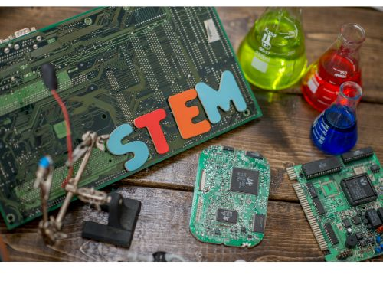
Unit 2: Bridging STEM disciplines in drone operations In which STEM areas can we use drones?
Section 2.1: STEM learning directions in drone operation
As much as drones are today's devices, their relationship to STEM subjects is directly related. Drones use all 4 areas of STEM learning.

Slide 8
Unit 3: Teaching subjects in drone training Subjects
Section 3.1: Drones in science subjects
Lifting power The dynamics of rowing
Lifting capacity - dead weight

Slide 9
Section 3.2: In technological subjects
Introduction to mechatronics
Control systems and feedback mechanisms
Actuators and sensors
Electronic control systems and programming
Types of aircraft lighting systems
Electrical and optical principles of aircraft lighting
Installation and maintenance of aircraft lighting systems

Slide 10
Section 3.3: In engineering subjects
Basic Electrical and Electronics Theory
Introduction to electrical and electronic systems in aircraft
Electrical and electronic theory and principles
Electrical safety and regulations
Electrical and electronic circuits and components
Introduction to avionics systems
Navigation and communication systems

Slide 11
Section 3.4: In mathematical subjects
Battery capacity - consumption
Rotor area - lifting capacity

Slide 12
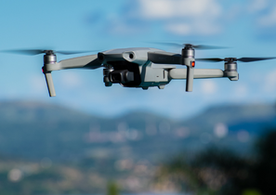
Summing up
STEM
COURSE
Is the future
learning metods
Graduated you
will know how to
handle wit drones
DRONES
GOALS
Drones are the future and we must know them
Keep up with
the future today

Slide 13
Thank you!

